Slide 1

IMDb Movie Genre Predictor
COM3029 – Natural Language Processing
Group 10
Tom Wilson
Kuan Hao Chen (Roger)
Lavinia-Iulia Fratila
Alexandros Constantinou (Alex)

Slide 2
Punctuation and bad characters removed, while accented characters are converted e.g, à -> a
Stop words removed with NLTK stop word list
Lemmatization must be used so that words are compatible with GloVe word embeddings

Slide 3
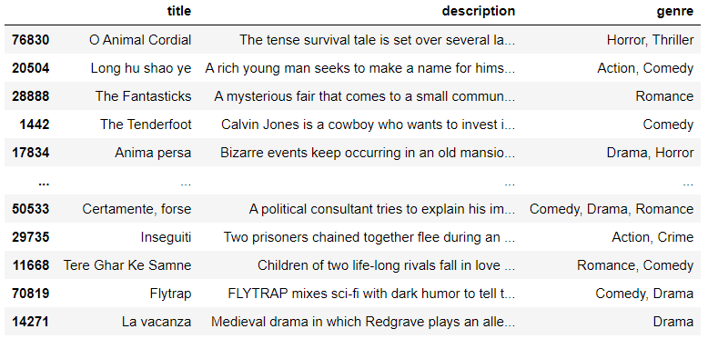
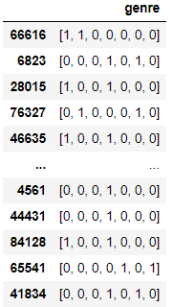
Problem is multi-label
Labels converted to multi-hot
Multiple labels predicted using a threshold 0.5

Slide 4
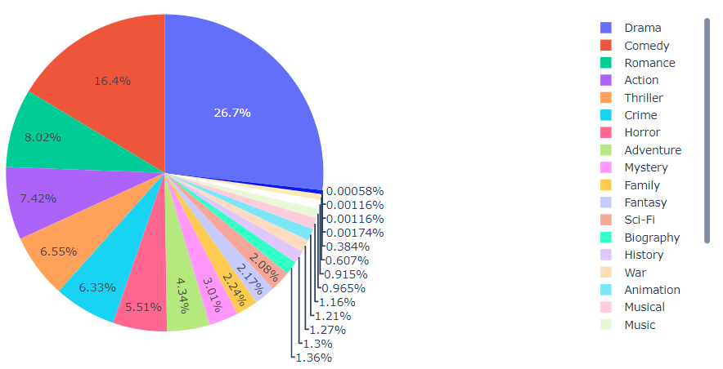
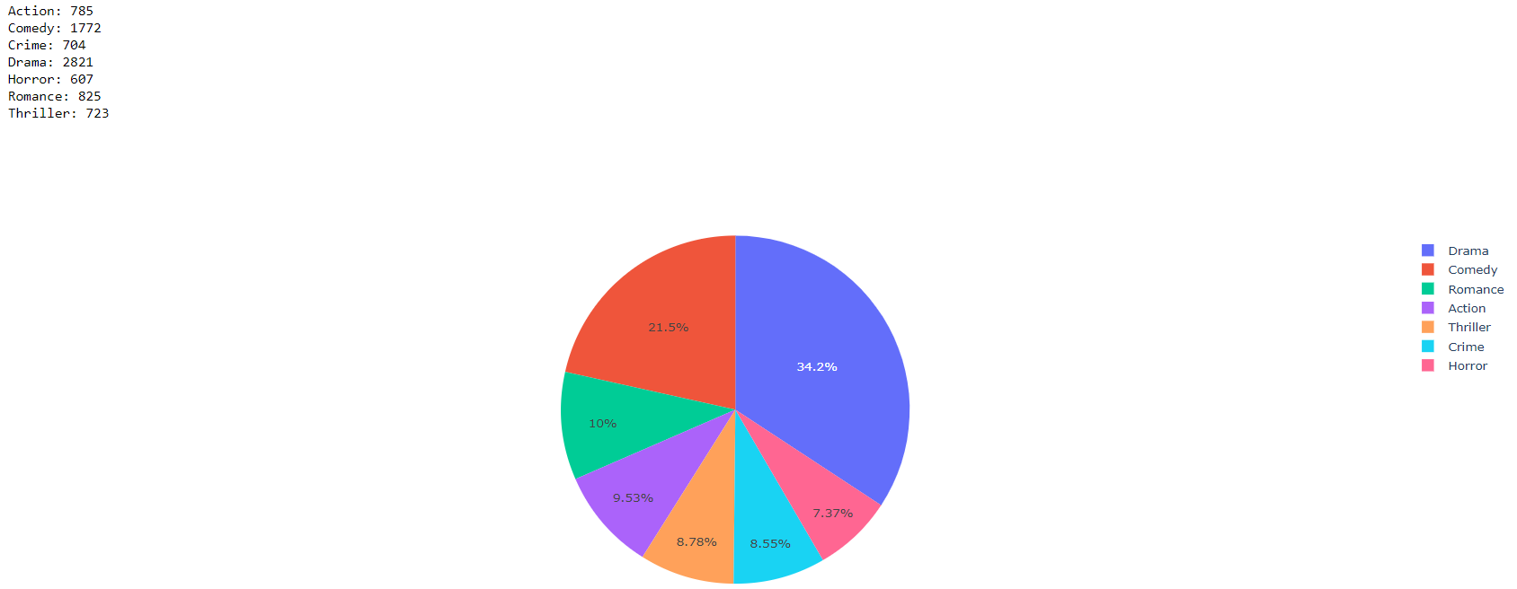
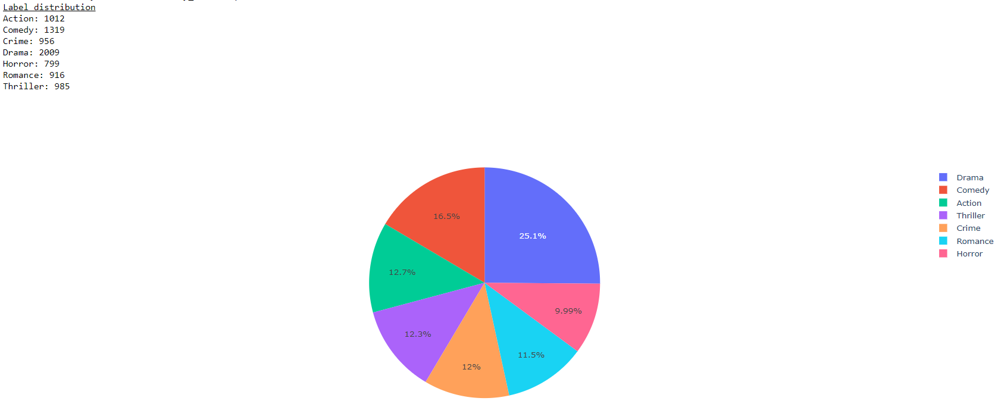
Improved the sample distribution
Not all genres have enough samples
Bad distribution resulted in always predicting Drama, comedy…
Images:
1) All 85855 samples
2) 5000 random samples
3) 5000 samples selected by genre

Slide 5
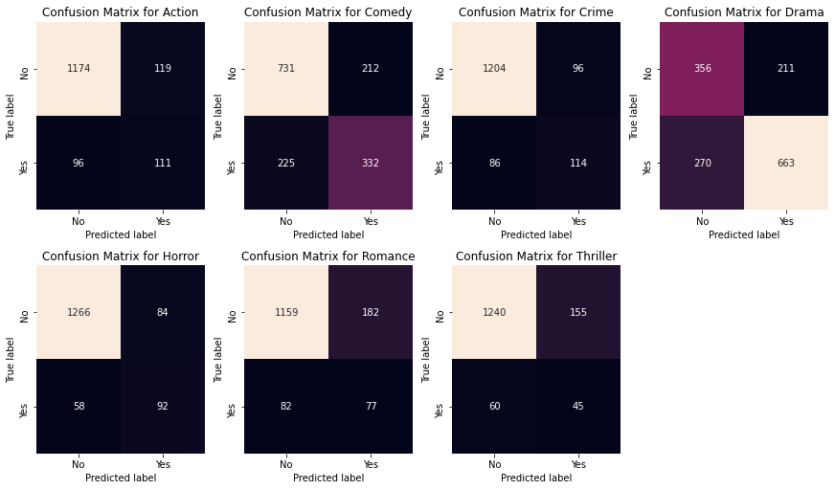
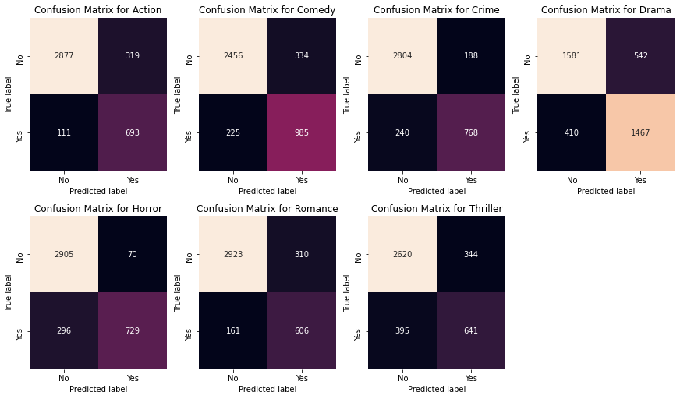
Batch normalization made a large improvement
LSTM without batch norm, 0.597 F1 27.2% accuracy
LSTM with batch norm 0.748 F1, 41.5% accuracy

Slide 6
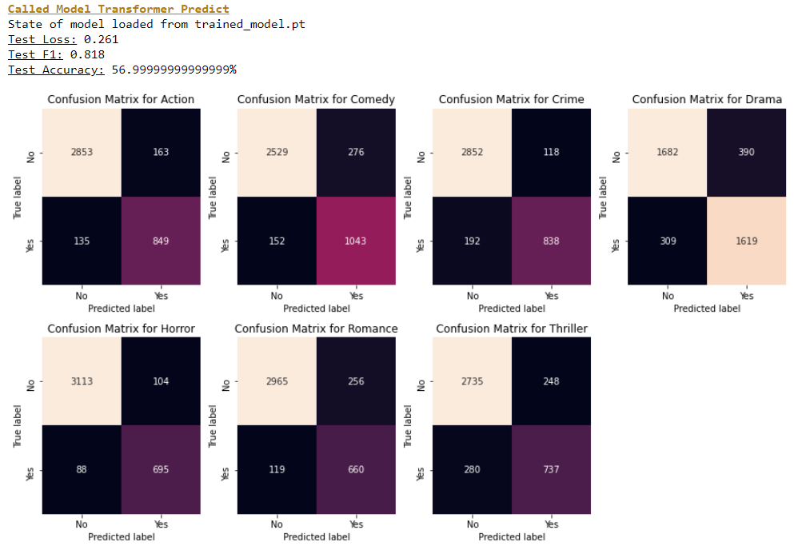

Slide 7
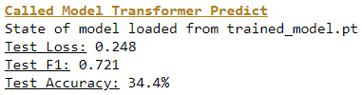
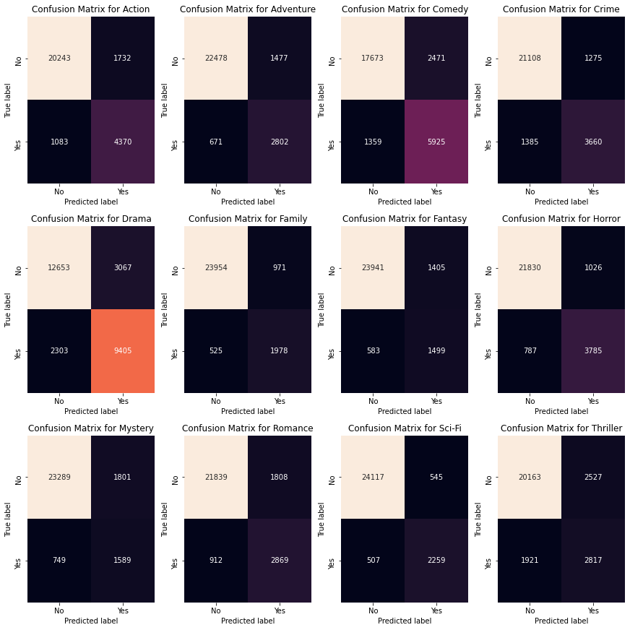
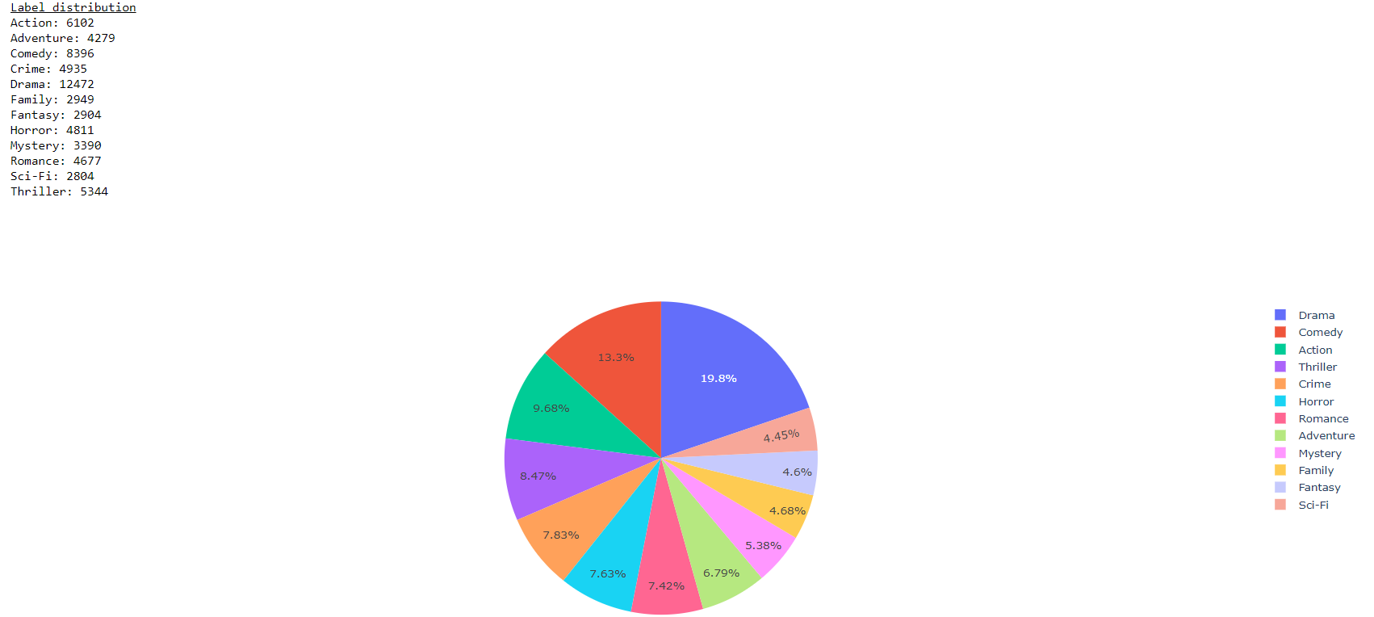

Slide 8
Tested transformer model too, accuracy not as high

Slide 9
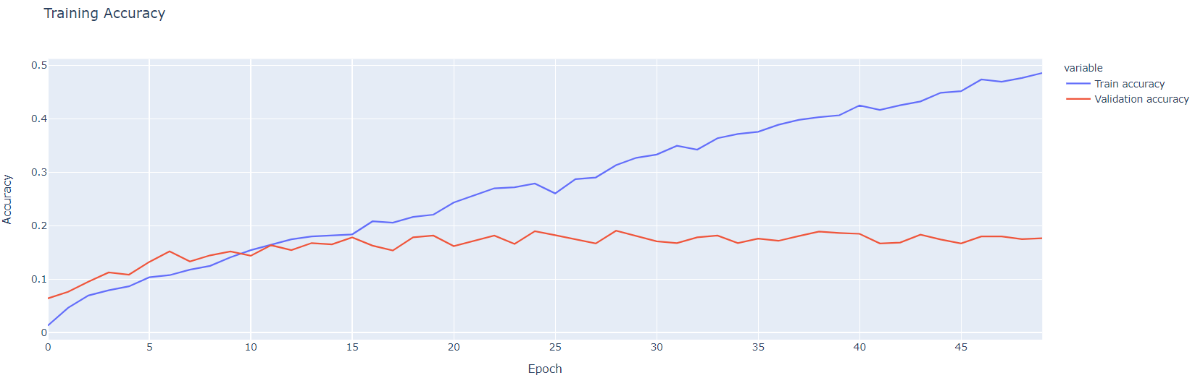
Training accuracy improves while validation accuracy tends to converge

Slide 10
Research different model serving option(s) and explain what would be the right choice for your case

Slide 11
Discuss the performance of the service you implemented, and justify the good and bad points

